Slide 1
The Architecture of Induction
How a simple ripple in a magnetic field powers our modern world.

Slide 2
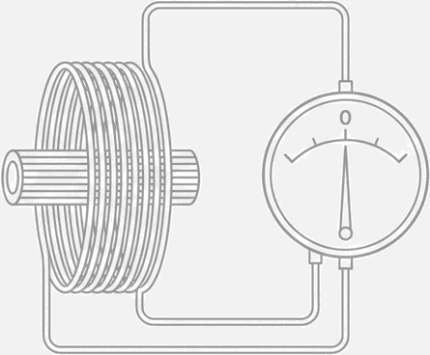
A Silent Potential
In stillness, electromagnetism holds its potential. A wire coil and a magnet, separate and static, share no energy.
The source text notes: "Stationary, the meter shows no current.”
G
NotebookLM

Slide 3
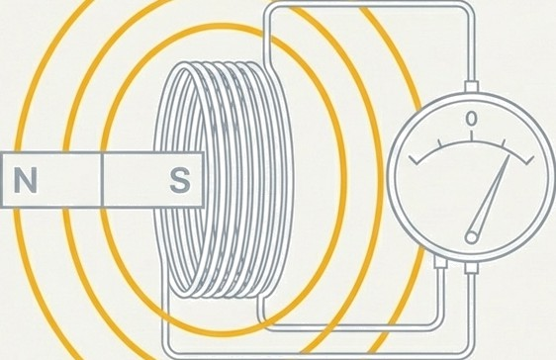
The Spark of Motion
Motion is the key. As the source material states, when you “move the magnet near or through the coil... the meter registers current.”
This movement creates "energy ripples," inducing an electric current where there was none.

Slide 4

Faraday's Law of Induction
This is electromagnetic induction, the core of Faraday's Law. It states: “A changing magnetic field within a circuit induces an electromotive force (or voltage).“
changing magnetic field
G NotebookLM

Slide 5
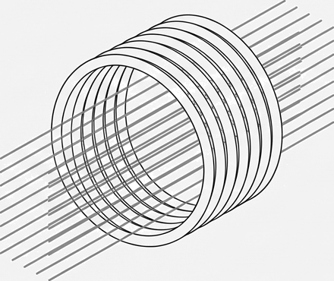
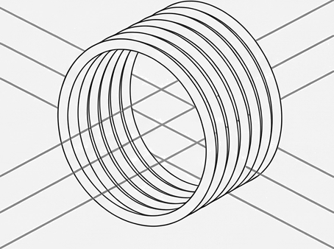
Understanding Magnetic Flux
The phenomenon is governed by “magnetic flux” a measure of the total magnetic field passing through a given area. As the source text clarifies, it is the change in this flux, not its mere presence, that induces a current.
Low Flux
High Flux
G NotebookLM

Slide 6
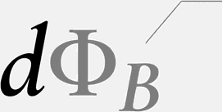

The Blueprint in an Equation
Elegantly expressed in mathematics, the law quantifies the relationship: the induced voltage
(e) is directly proportional to the rate of change of the magnetic flux (d‹t›_{B}/dt).
Change in
Magnetic Flux
Induced Electromotive
Force (Voltage)
Over a Period of
Time
(Lenz's Law) Direction of
the induced current opposes the change that created it.
’’
G NotebookLM

Slide 7
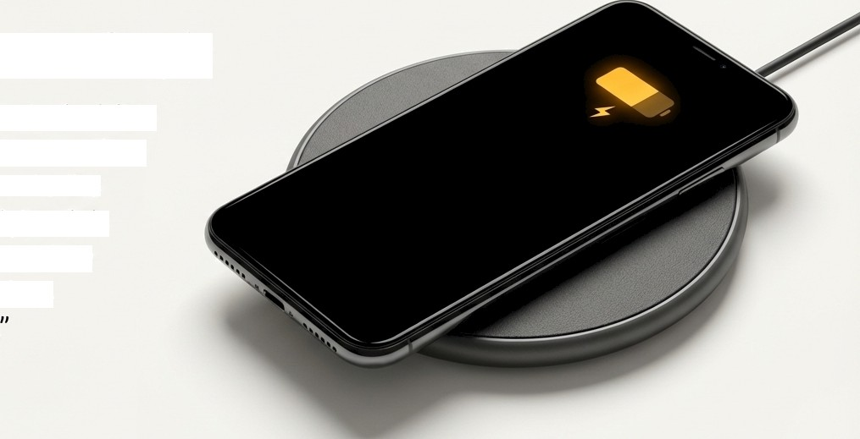
From a Law to a Lifestyle
Faraday's discovery is the invisible
engine behind our most seamless
modern conveniences. As the source material highlights, it is "the principle behind modern technologies like wireless charging for devices.
G NotebookLM

Slide 8
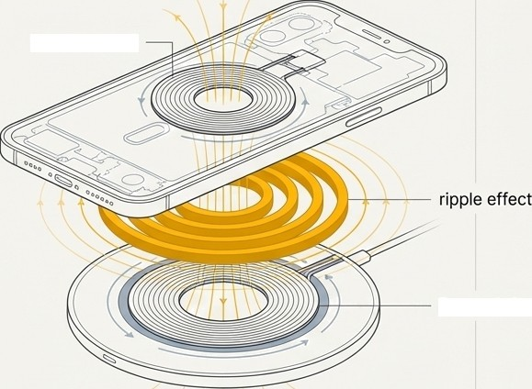
The Architecture of Unwired Charging
The source explains: "In wireless charging, the pad's transmitting coil creates a fluctuating magnetic field, inducing current in the device's receiving coil." This changing flux powers the device without physical connection.
Receiving Coil
Transmitting Coil

Slide 9





A Seamless Energy Transfer
It is a perfect transfer of energy, orchestrated by one fundamental principle, enabling us to "power devices without physical connections, simplifying lives.”
AC Power from Wall
Transmitting Coil
Fluctuating Magnetic Field
Receiving Coil
Rectifier to DC Power
Device Battery

Slide 10




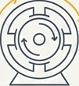


Beyond the Charging Pad
The principle of induction is fundamental to our technological world. As the source notes, ”From power generation to gadgets, Faraday's Law shapes our technologically advanced world.”
Electric Generators
Power Grid Transformers
Electric Motors
Induction Cooktops
Contactless Card Readers
G NotebookLM

Slide 11
The Enduring Current of Innovation
From a simple observation of a magnet and a coil comes a fundamental law that continues to enable innovation. Faraday's Law is not just physics history; it is
the silent, invisible architecture of our technological future.
G NotebookLM

